Slide 1
Sensitivity analyses
Oversampled districts (n>10) downsampled randomly
Keeping minimum of 100seq

Slide 2
Transition | Change
north → south | ↓ ~5%
south → north | ↑ ~34%
✔ still directional constraint
north → south consistently stronger
Full:
~3.0× stronger north → south
DS:
~2.1×
Directionality exists (north → south ~3× → 2.1×)
But asymmetry shrinks more under downsampling (~30% reduction)
Weak direction becomes stronger when data are removed
Partial/ episodic constraint

Slide 3
Transition | Relative change
periurban → urban | ↓ ~30%
urban → periurban | ↓ ~44%
Statistical support remains despite drop
(decisive to v strong)
Full model
~3.7× stronger urban → periurban flow
DS
~3.0× stronger urban → periurban flow
Downsampling reduces inferred movement intensity (30–45%) but preserves the overall directional structure of urban–periurban transitions
Asymmetry pattern is robust, magnitude is moderately sensitive (primarily driven by Cerro Colorado?)

Slide 4
High-support transitions remain broadly stable
Lower-supported routes have greater variability in both BF and MJ (BF>50 as a threshold?)
Core movement network remains stable
Cerro Colorado routes (particularly to yura) are sample-sensitive but real

Slide 5
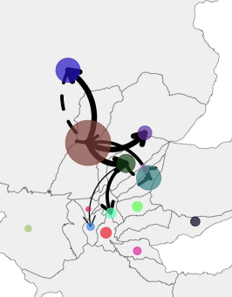
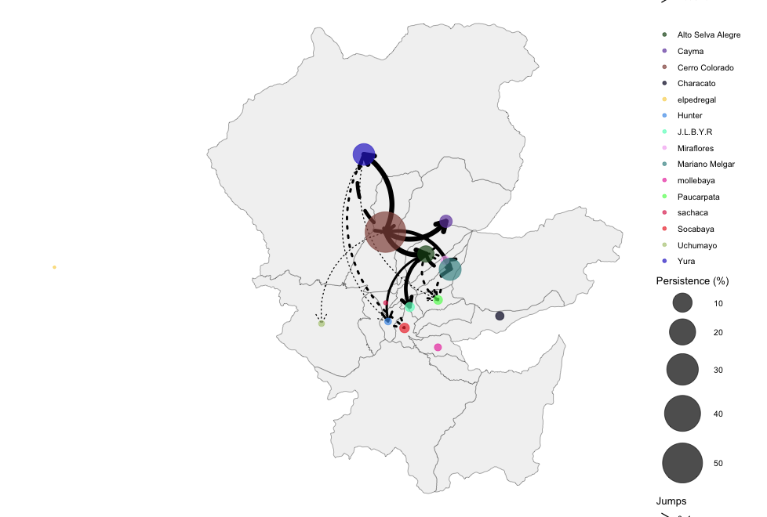
Removing BF<50
Original
BF>10

Slide 6
Overall
Urbanicity = most stable directional system
River = intermediate stability, more sampling-sensitive
District = heterogeneous / edge-dependent stability

Slide 8
16 years of epidemiological silence in Arequipa city
Rabies re-emergence and persistence
REDIPRA 14 declares Arequipa rabies-free
Rabies re-emerges in Arequipa city
Rabies persistence in Arequipa City
1999
2014
2021/22
2013
2015
2025
Last detected case in Arequipa city and Region
Two canine rabies cases in Camaná
Rabies outbreaks in El Pedregal

Slide 9
16 years of epidemiological silence in Arequipa city
Rabies re-emergence and persistence
REDIPRA 14 declares Arequipa rabies-free
Rabies re-emerges in Arequipa city
Rabies persistence in Arequipa City
1999
2014
2021/22
2013
2015
2025
Last detected case in Arequipa city and Region
Two canine rabies cases in Camaná
Rabies outbreaks in El Pedregal

Slide 10
A
16 years of epidemiological silence in Arequipa city
Rabies re-emergence and persistence
REDIPRA 14 declares Arequipa rabies-free
Rabies re-emerges in Arequipa city
Rabies persistence in Arequipa City
1999
2014
2021/22
2013
2015
2025
Last detected case in Arequipa city and Region
Two canine rabies cases in Camaná
Rabies outbreaks in El Pedregal
B
C

Slide 11
Main Arequipa lineage
El Pedregal 2021
Historical Puno

